Slide 1


Best Practices for Research, Online Learning & Blogging
June – July 2017
Katy Dickinson
dickinson@mentoringstandard.com
mentoringstandard.com
Jessica Dickinson Goodman
jessica.dickinson.goodman@gmail.com

Slide 2
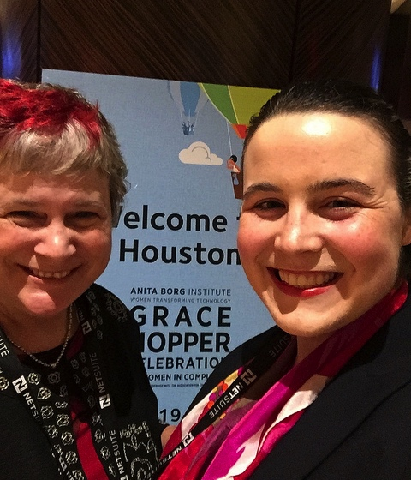
This is us:
<- Katy Dickinson with daughter
Jessica Dickinson Goodman
at GHC16: the
Grace Hopper Celebration of Women and Computing,
Houston Texas, October 2016
We have traveled together in Qatar, Egypt, Jordan, Lebanon, Israel, Gaza, the West Bank, and now Sierra Leone!
Follow us on Twitter:
@Katy_Dickinson
@JessiDG
Download this presentation at: mentoringstandard.com

Slide 3
3 Topics
Research
      For a uni paper
      To answer a friend’s question
Online learning
      Suggested MOOCs: FutureLearn, Khan Academy, OpenCurriculum, Coursera, Stanford Online, HarvardX, MITx, Crashcourse, Lynda, Edx
      Wikipedia (How to use and not use it)
Contributing to Global Knowledge
      Blogging
      Wikipedia
      Research

Slide 4
Kinds of Research
Internet Research: collecting information from the web
  Search Engines are the Starting Point: Google, Bing, Yahoo, etc.
  Wikipedia: free online encyclopedia
Offline Research: looking up information on paper
  A surprise gift!
  Journals
  Librarians/Professors/Experts
  Local archives and museums
  Interviews, photographs, paintings, oral histories

Slide 5
Online Research
Best Practices

Slide 6
How I Think About Research
Start with a real question
Gather a wide range of opinions and data
Evaluate how much you trust each opinion and understand the writer’s point of view
Synthesize data and opinions from others
Contribute your findings to society

Slide 7
Online Learning

Slide 8
MOOCs:
Massive Open Online Courses
      These online educational sites offer excellent free courses, delivered on the web.
      Some of our favorites:
        FutureLearn
        Khan Academy
        Coursera
        Stanford Online
        HarvardX
        MITx
        CrashCourse
        CGPgrey
        Udemy
        edX
        Iversity
        Open2study
        NovoEd

Slide 9
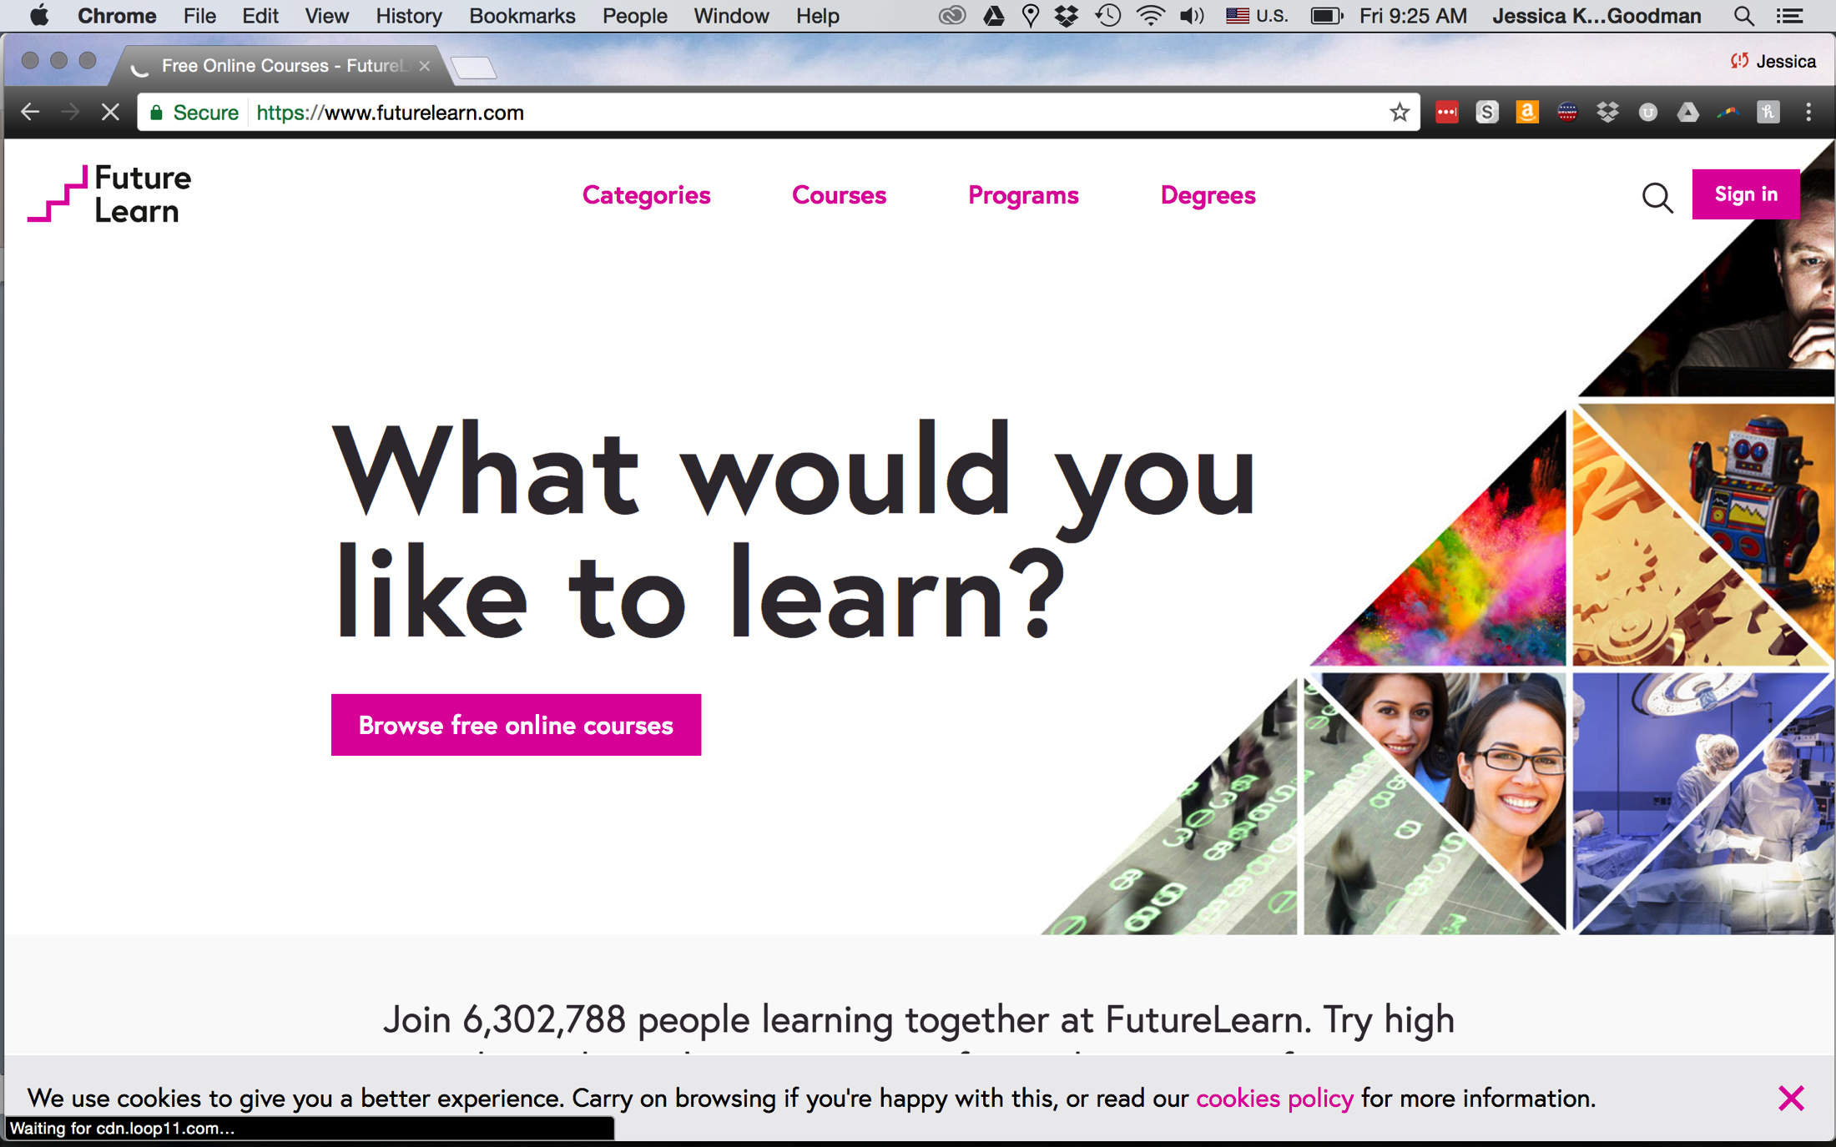

Slide 10
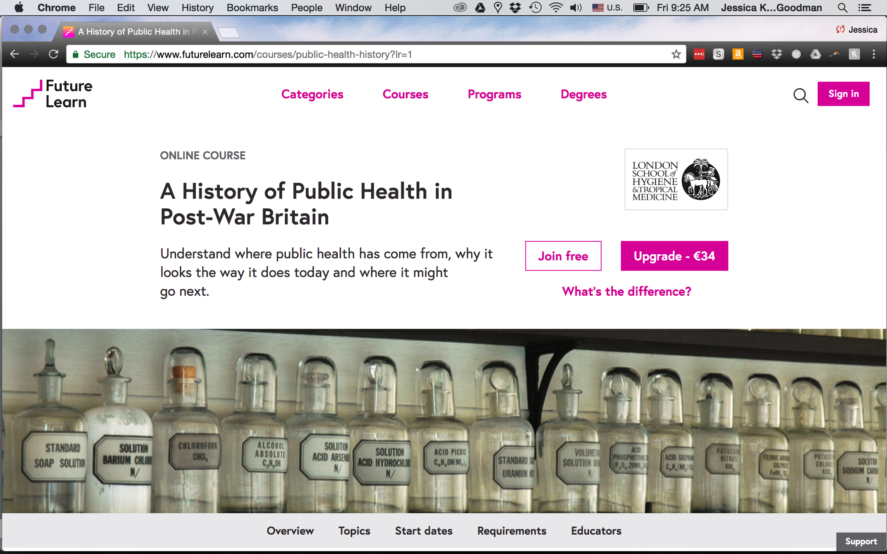

Slide 11
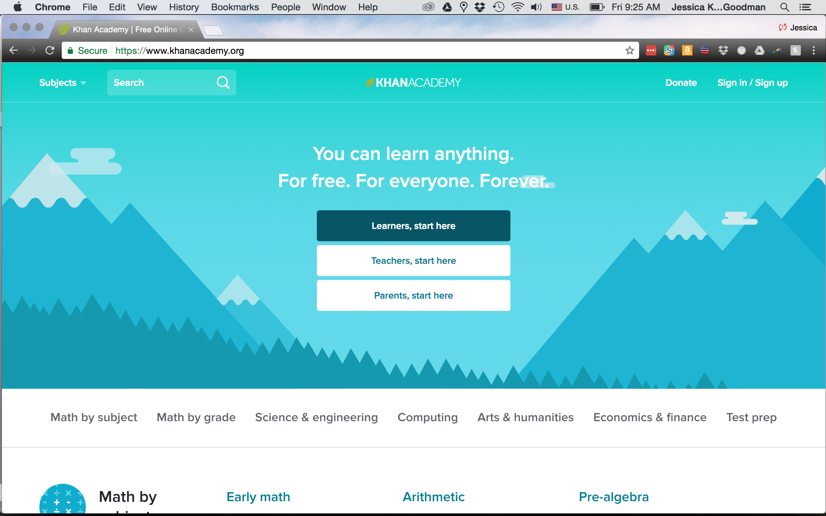

Slide 12
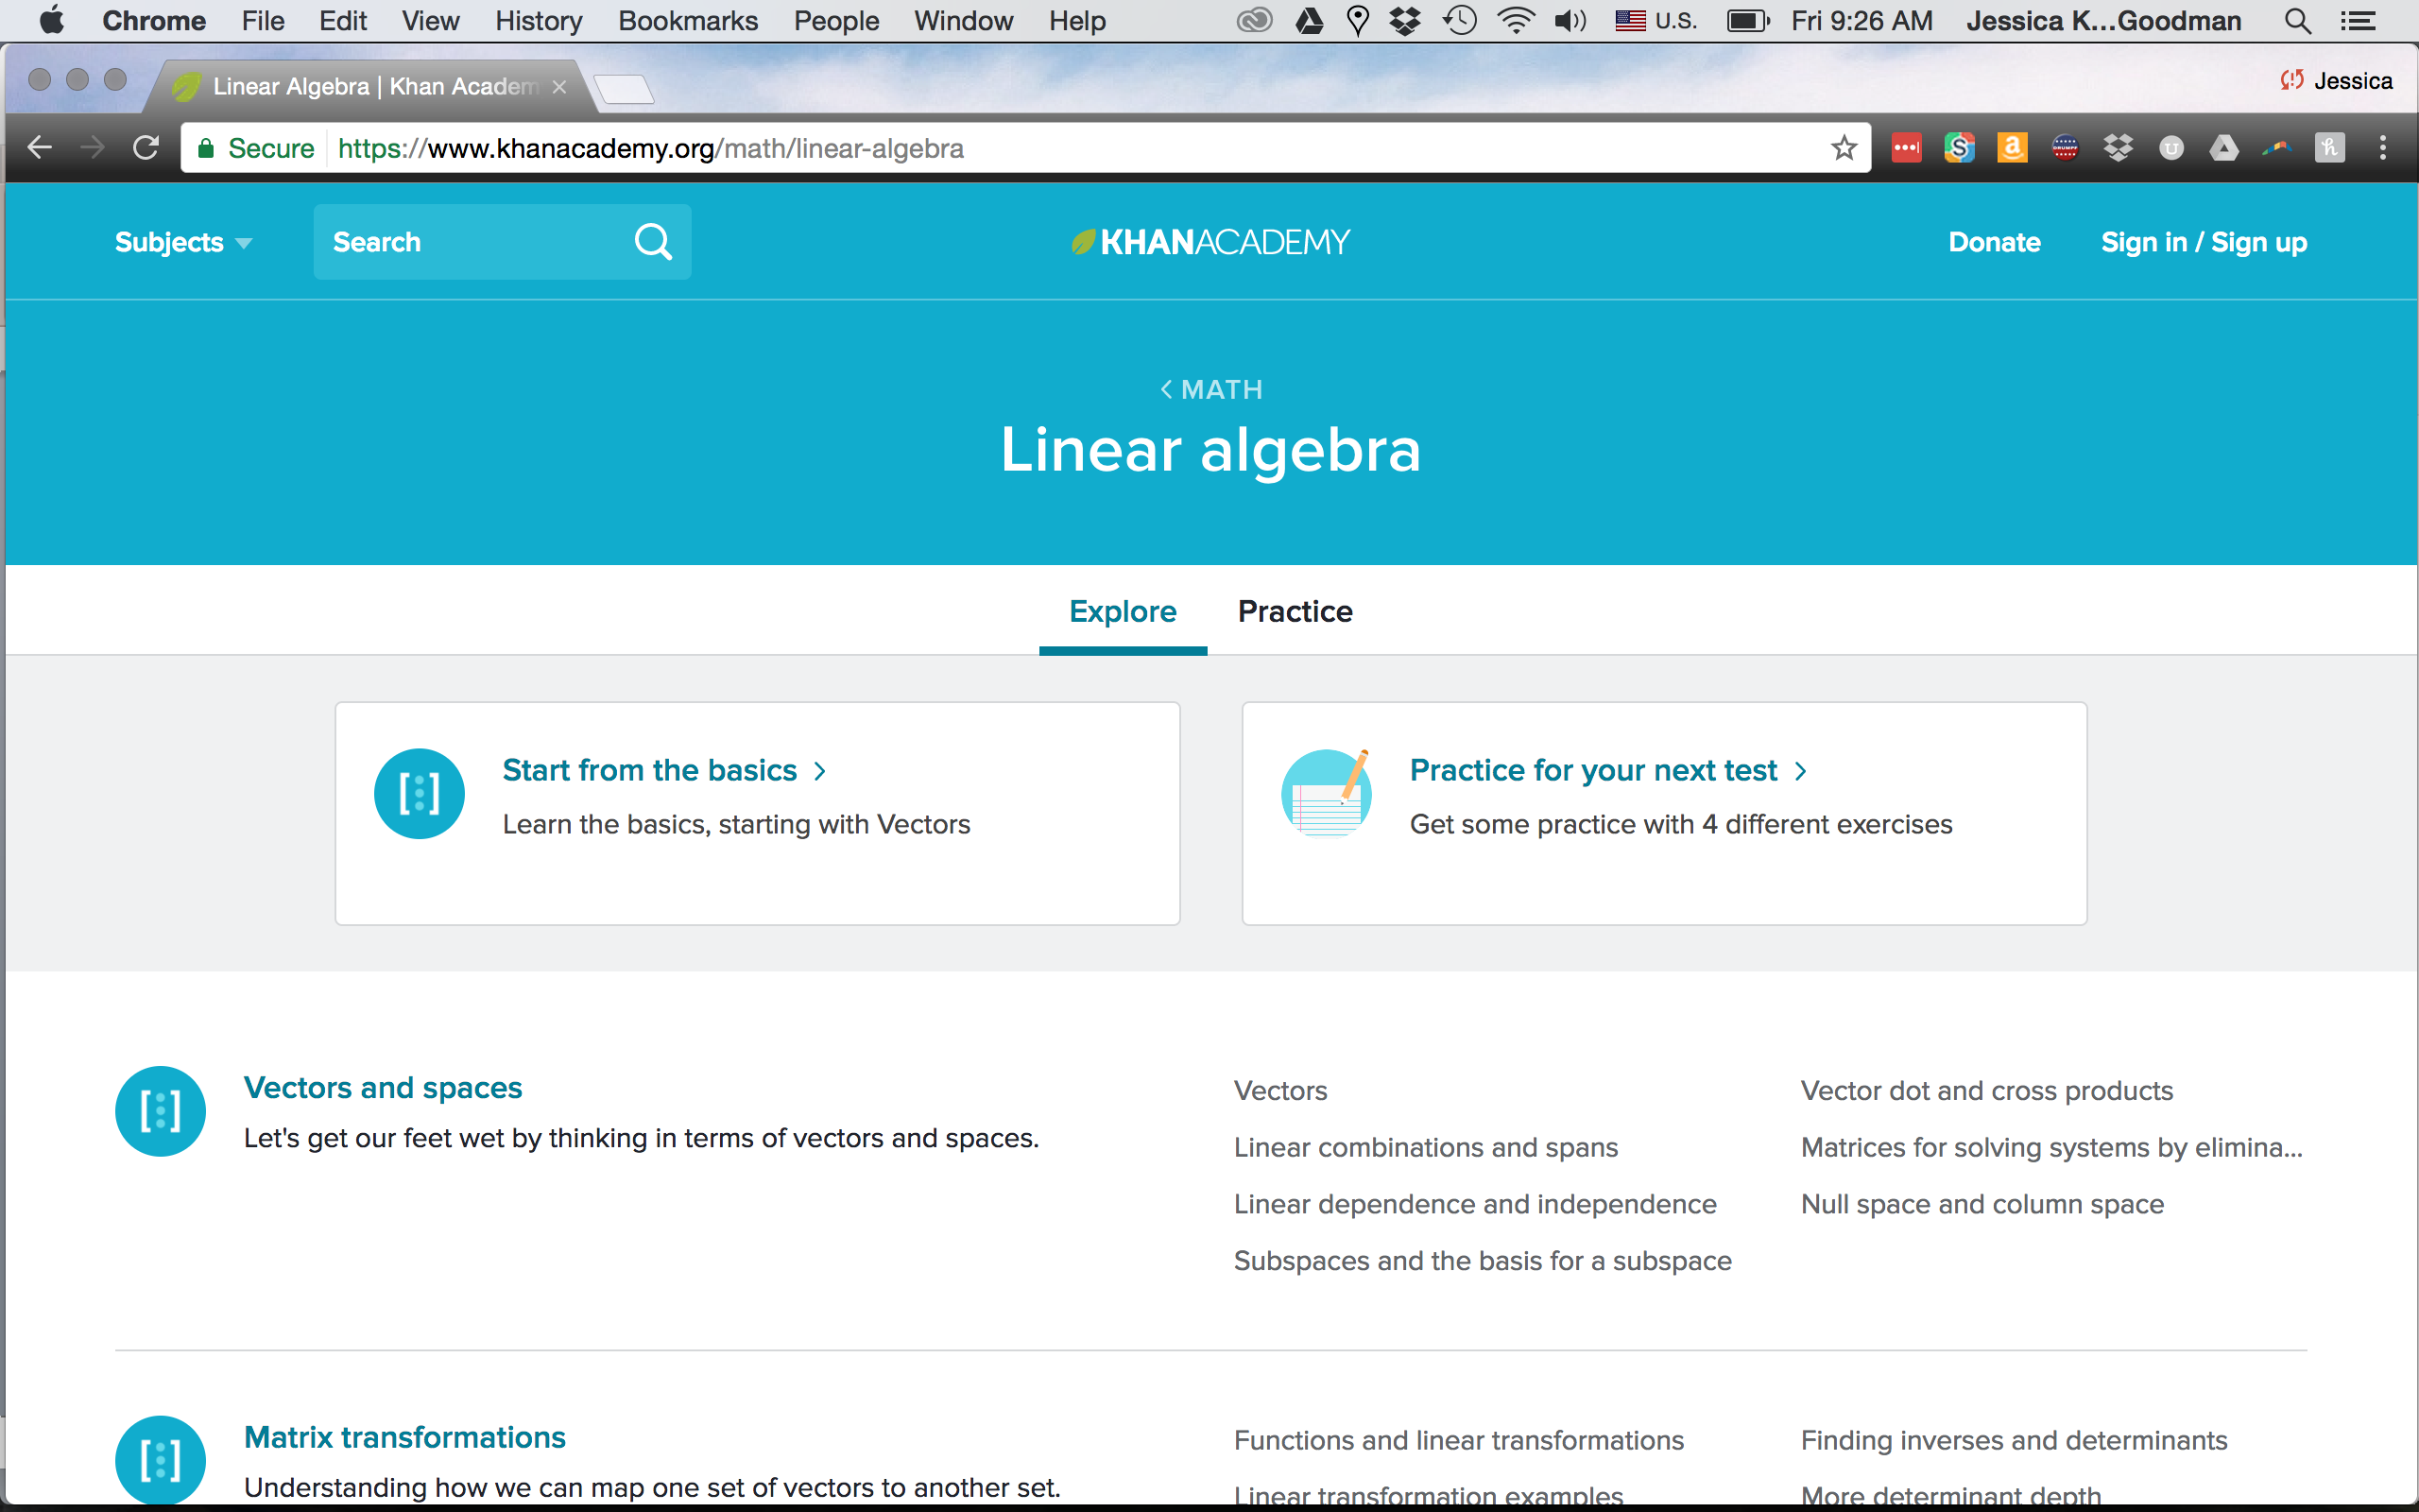

Slide 13
Deep Dive: FutureLearn
(Live Demo by Katy)

Slide 14
Contributing
to Global Knowledge:
How to Blog

Slide 15
Katy’s History as a Blogger
Writing Katysblog since 2005.
1,750+ posts on https://katysblog.wordpress.com
2,330 regular readers (blog subscribers).
Many more read Katysblog through LinkedIn, Twitter, and Wordpress.
Contribute articles to other blog sites from time to time.
Katy’s company Mentoring Standard also uses Wordpress as a website platform: mentoringstandard.com
Jessica is the Web Monarch (technical owner) for Mentoring Standard

Slide 16
What is a Blog?
A Blog (or web log) is a discussion or information site on the World Wide Web made up of entries or posts, with the most current displayed first. Blogs can be:
  Original - or curated
  Contain only text - or text with images
  Written by one - or many authors
  Interactive (with readers leaving comments) – or not.
  Popular free services: Wordpress, Medium, Ghost, Joomla.
A Microblog is a form of blog that is smaller in size.
Popular free services: Twitter, Tumblr.
A Photo Blog is focused more on images than text.
Popular free services: Instagram, Flickr, Pinterest.

Slide 17
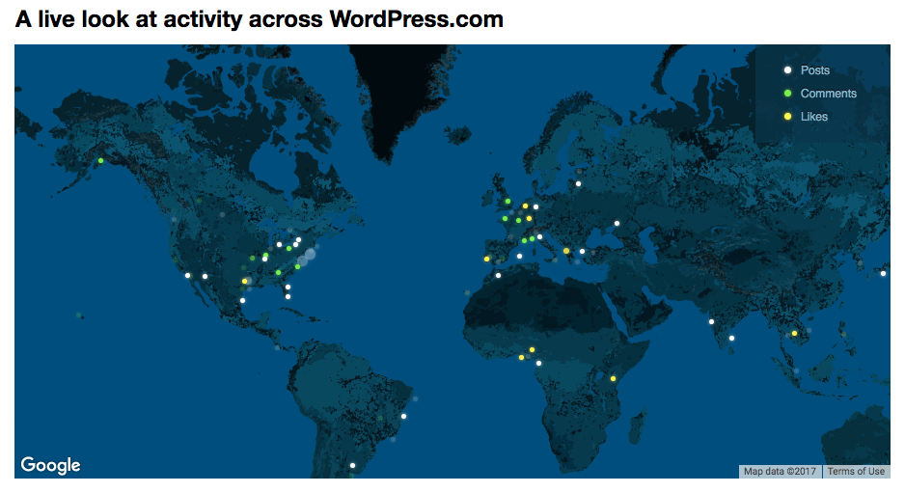
Why Blog? To Be Heard!
Wordpress stats:
409 Million people view more than 23.7 Billion pages each month.
83.1 Million new posts and 44.5 Million new comments each month.
Image from https://wordpress.com/activity/

Slide 18
Why is a Blog Useful?
Communicating with community, family, friends.
Enlarging your circle, telling your story through personal experience, informing the world in your own words about your culture, community, context.
Learning how to write for a big audience, interacting with readers.
Improving your research and writing composition skills through regular practice.
Having fun!

Slide 19
Group Blogging
To write a blog with a group, you need Structure and a Schedule. Decide:
Structure
  Who is your audience?
  What are both you and your audience interested in? (Suggestions: School work, Home life, Music, Sports, Local culture, Cooking, Fashion, and Beauty)
  Does each person write, or are there teams of writers?
  What language or languages will this blog be in?
  Who is the Editor?
    Job: Refining expression, Consistency of voice and presentation, Fixing grammar and spelling, and Gatekeeping between writers and their audience.
    Must be: A good writer / composer, detail oriented, very organized, diplomatic.
  Who is the Photographer?
    Job: Illustrating her own and others’ blog posts.
    Must have access to a digital camera, or a smart phone with a camera.
    Must be: Creative, excited by form/color, detail oriented, very organized, diplomatic.
Schedule
  Frequency of posting: Weekly? Twice Monthly? Monthly?
  Schedule for each person or team to write a post.

Slide 20
How to Write a Blog 1
Every writer must find her own voice, style, and audience.
The best way to learn to blog is to read other people’s blogs, then write your own.
Blogs from Sierra Leone to read for comparison:
  Sierra Leone or Bust: http://emilyinsierraleone.blogspot.com/
  Sandra’s Latest: http://sandralako.blogspot.com/
  MSF in Sierra Leone: http://blogs.msf.org/en/staff/blogs/msf-in-sierra-leone
A consistent publishing schedule, images, and quality writing make your readers want to come back.

Slide 21
How to Write a Blog 2
In putting together each blog entry, focus on 3 areas, in this order:
  Topic
  Images
  Writing Composition
Consider a single topic for each entry, starting with a subject of special interest.
Within that general requirement, each entry topic must also be one or more of the following:
  Entertaining
  Educational or Historical
  Newsworthy

Slide 22
How to Write a Blog 3
Decide what matters to you and your audience, then write about it.
If you enjoy taking pictures: a photo will often inspire a blog entry – with text expressing what is of interest in that image.
Once you start composing, work to ensure that not one word is wasted. Be respectful of your reader’s time and precious attention by being succinct and clear.
Three words of advice for successful bloggers:
  Be authentic.
  Be respectful.
  Be brief.
Once you have established your blog, ask your family, friends, and community to read it and send you comments.

Slide 23
What to Avoid
There are topics and behaviors to avoid if you want to be a convincing, effective, and respected blogger:
Do not take other people’s words or images without permission. This is plagiarism and copyright infringement.
Avoid nasty politics, personal ridicule, vulgarity, fake news, gossip, and too-private information.
Remember: you are speaking for yourself, your family, your school, and your community. Your readers will judge them by you.

Slide 24
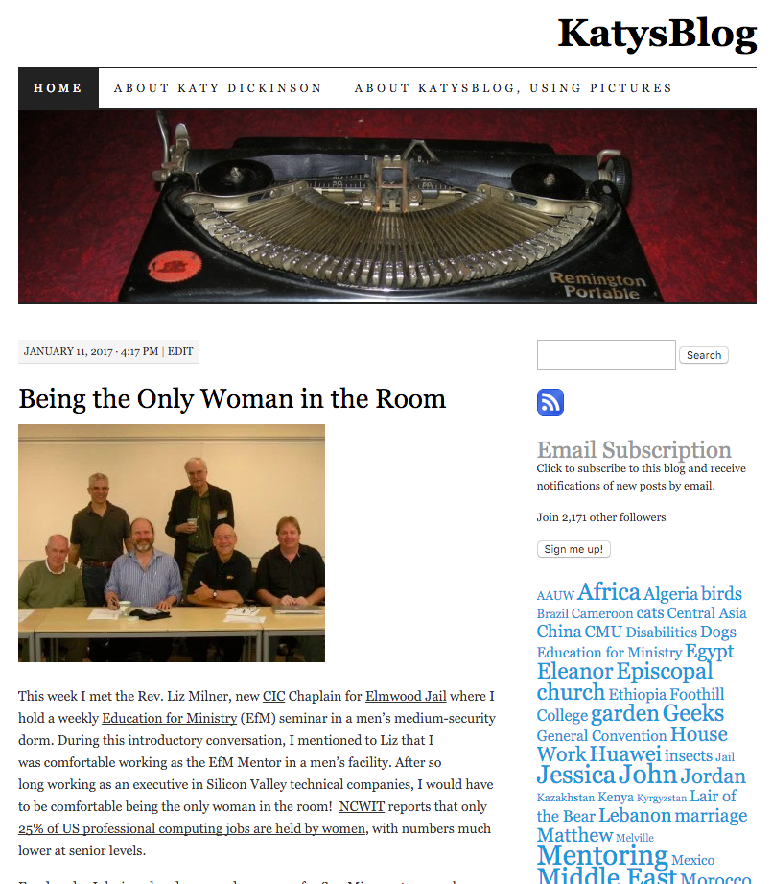
What a Blog Looks Like: Outside
Blog Title: KatysBlog
Pages/Tabs: Home, About …
Home Page Theme Photo
Left: Date/Time of Most Recent Post
Right: Search Bar
L: Blog Title
L: Top Photo in Blog Post
R: Subscription Button
R: Count of Subscribers
L: Blog Content
R: Word Cloud – Most Common Used

Slide 25
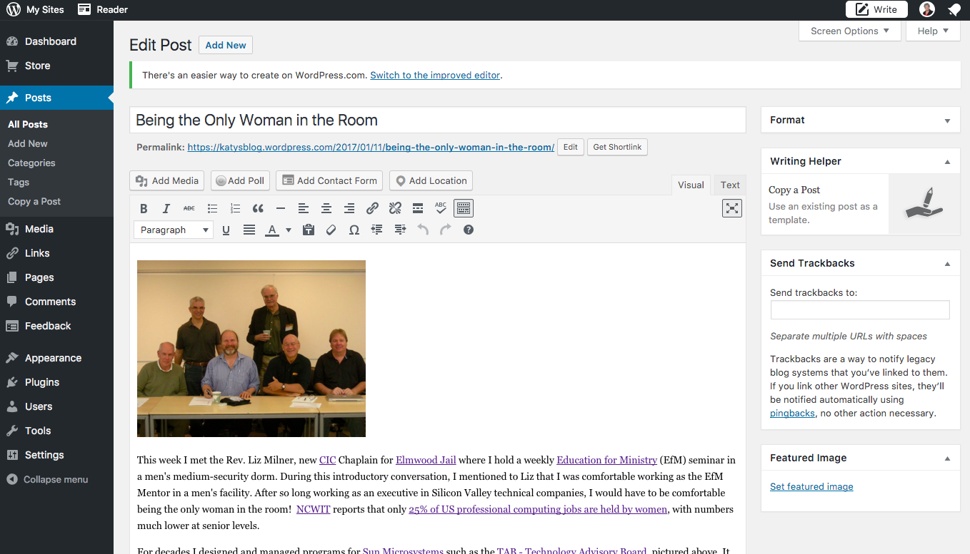
A Blog Inside: Visual View
Left: Navigation Bar for Information and Design (“Nav”)
Middle: Blog Title
Middle: Permalink, Control Buttons
Middle: Visual of Post Content
Right: Management Tools

Slide 26
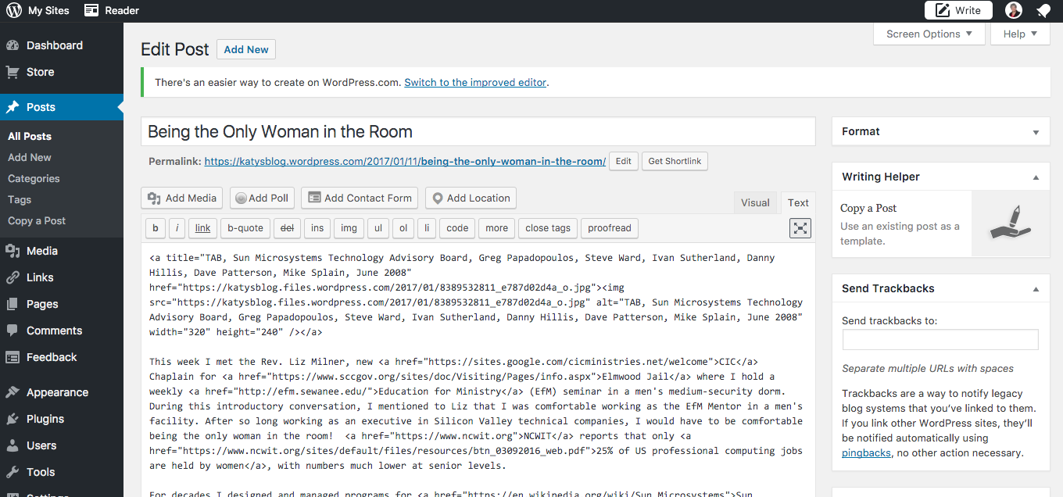
A Blog Inside: Text View
Left: Navigation Bar for Information and Design (“Nav”)
Middle: Blog Title
Middle: Permalink, Control Buttons
Middle: HTML of Post Content
Right: Management Tools
HTML Basic Tags:
https://www.tutorialspoint.com/html/html_basic_tags.htm
HTML Cheat Sheet:
http://www.simplehtmlguide.com/cheatsheet.php

Slide 27
Creating a Blog Post
Now, we will take a live tour of Katysblog, then
create a blog post together. Decide:
Who is your audience?
What are both you and your audience interested in?
Topics to consider:
  School work
  Home life
  Music
  Sports
  Local culture
  Cooking
  Fashion and Beauty
What is your blog post’s Title?
What do you want to say?
What pictures do you want to feature?
Review and reconsider, edit as needed, then post.

Slide 28
5 Other Ways to Contribute
Write a book or monograph
Submit an article to an academic journal
Edit or make a new Wikipedia page. Here’s how: http://www.cs.duke.edu/csed/wikipedia
Post about your insights on social media
Build a website that answers your research question

Slide 29
Summary
Research
You have so many sources, discerning which ones to trust and highlight is your biggest obstacle.
Learn Online
You can take courses by professors at Harvard, Stanford, and MIT for free and online to supplement your studies.
Contribute
We hope at least 3 of you start blogs on Sierra Leone so we can share them with all of our friends around the world and help them know more about your wonderful country.

Slide 30
Questions?
Katy Dickinson
dickinson@mentoringstandard.com
mentoringstandard.com
Jessica Dickinson Goodman
jessica.dickinson.goodman@gmail.com

